Slide 1
Writing Business Letters
Dr Smita Mayekar
Associate Professor
Hirachand Nemchand College of Commerce, Solapur

Slide 2
Contents
Parts of a Letter
Formats/ Styles of a Business Letter
Sample Formats
Guidelines for writing an Effective Business Letter(7 Cs)

Slide 3
Parts of a Business Letter
Heading—Letter head address
Most companies use letterhead--stationery with the company’s logo, name, address and other contact details
If the company does not have letterhead, the company’s full name and address should be typed at the top of the page in accordance to the format used.
Date line
Never write the date using all numerals. Use the month name spelled out, then the day, followed by year in the four-digit year, for example, June 6, 2010.
Reference
Include a reference line to identify a file or case number, invoice number or any other internal identifying information, if your company requires one.

Slide 4
Cont…….
Addressee—Inside address
Your letter should include the name of the addressee /
receiver , designation, company name and full address, including
the postal code.
Subject
Normally the subject sentence follows the word “Subject:” or
“Re:” (regarding).
Salutation
Most salutations in Business Letters begin with “Dear”
followed by either the recipient’s first name, or title and last name.
However, if you don’t know the person’s name, use Dear Madam/
Sir, or the job title, such as Dear Accounting Manager.

Slide 5
Cont…
Body Paragraphs
The opening paragraph should always state why you are writing. Then explain the situation, the solution, the suggestion or whatever other message you need to get across to the recipient. Start a new paragraph whenever you begin a new subject.
Complimentary Close
complimentary closure It is a short, polite closing followed by a comma. When the letter is impersonal, use “Yours truly.” If the letter is to someone above you in rank, use “Respectfully yours.” If you have a personal connection to the addressee, use “Sincerely” or “Sincerely yours
Signature
Four spaces below the close, type your full or business name. In the space in-between, you will hand write your signature in ink. Use black or dark blue ink for your signature.
Notation:
. Add the notations like enc, cc if required

Slide 6
Formats/Styles of Business Letter
Block Format
Modified Block
Semi Block

Slide 7
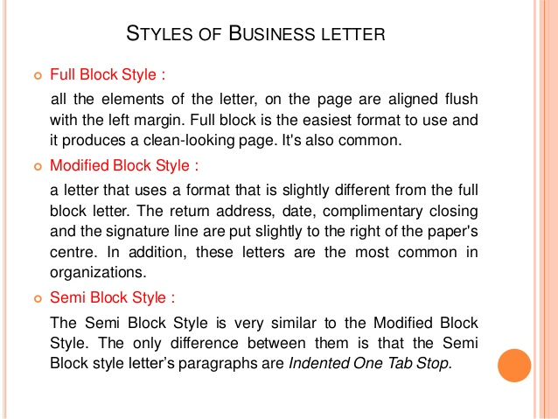

Slide 8
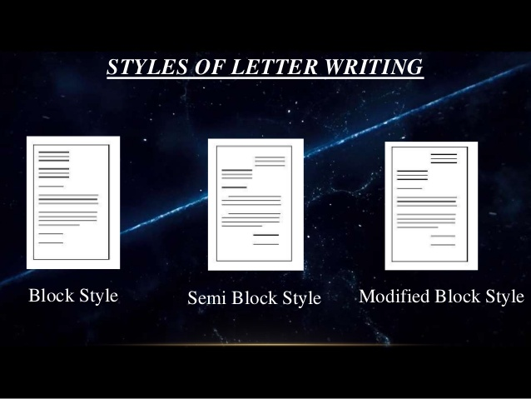

Slide 9
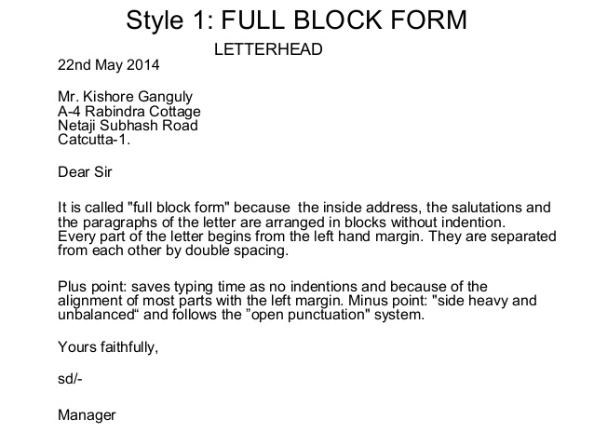
Sample Letters

Slide 10
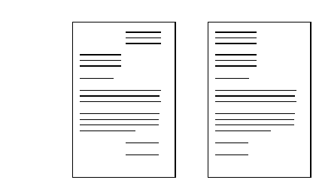
Modified Block / Full Block

Slide 11
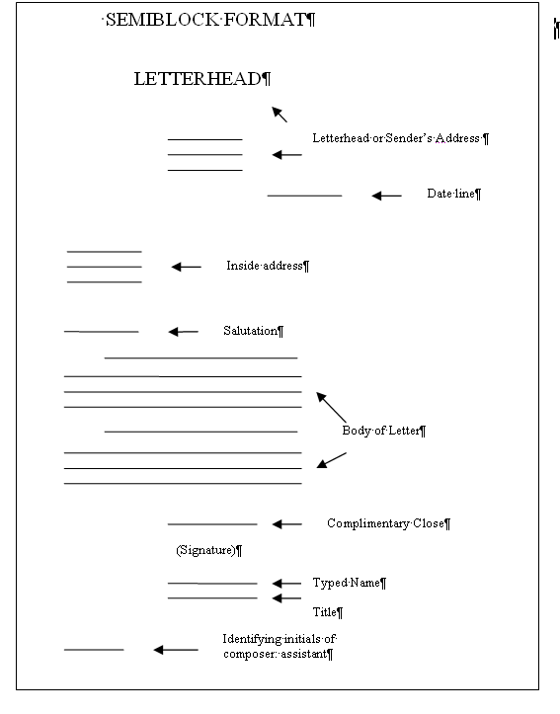
Semi Block Format

Slide 12
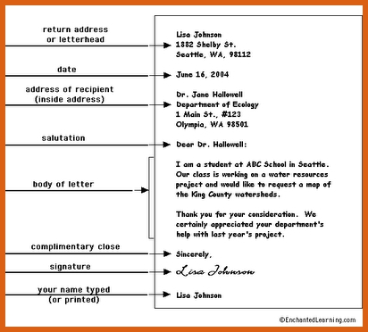

Slide 13
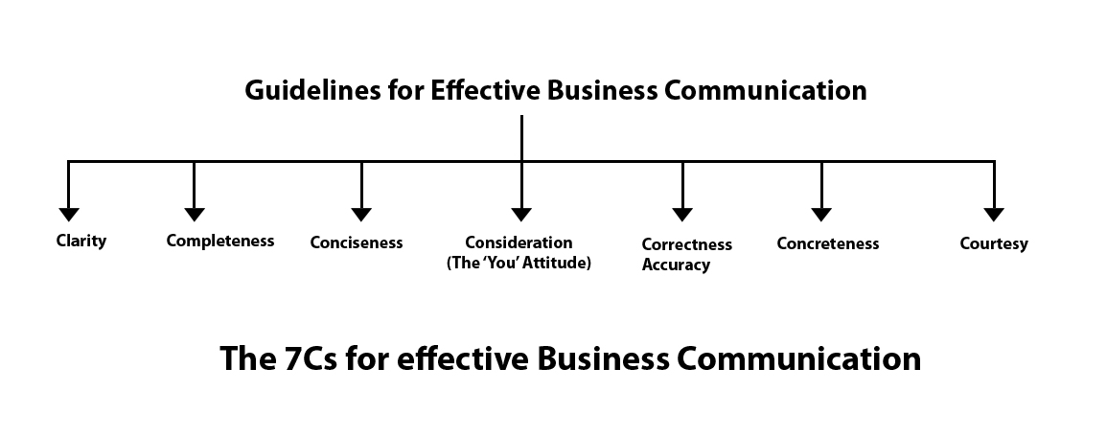

Slide 14
Completeness and Consideration
The message must be complete. It should convey all the facts required by the audience.
The sender of the message must take into consideration the receiver and should communicate all the facts and figures related to the message.

Slide 15
Conciseness
Conciseness means communicating what you want to convey in least possible words. Conciseness is a necessity for effective communication.
Concise communication has following features:
It is both time-saving as well as cost-saving.
It underlines and highlights the main message.
Concise communication provides short and essential message in limited words to the audience.
Concise message is more appealing and comprehensible to the audience.

Slide 16
Consideration Consideration implies “stepping into the shoes of others”. Effective communication must take the audience into consideration, i.e, the audience’s view points, background, mind-set, education level, etc. Make an attempt to envisage your audience, their requirements, emotions as well as problems. Ensure that the self-respect of the audience is maintained and their emotions are not at harm.

Slide 17
Clarity
Clarity implies emphasizing on a specific message or goal at a time, rather than trying to achieve too much at once. Clarity in communication has following features:
It makes understanding easier.
Complete clarity of thoughts and ideas enhances the meaning of message.
Clear message makes use of exact, appropriate and concrete words

Slide 18
Concreteness
Concrete communication implies being particular and clear rather than fuzzy and general. Concreteness strengthens the confidence.
Concrete message has following features:
It is supported with specific facts and figures.
It makes use of words that are clear and that build the reputation.

Slide 19
Courtesy
Courtesy in message implies the message should show the sender’s expression as well as should respect the receiver. The sender of the message should be sincerely polite, judicious, reflective and enthusiastic.
Courteous message has following features:
Courtesy implies taking into consideration both viewpoints as well as feelings of the receiver of the message.
Courteous message is positive and focused at the audience.
It makes use of terms showing respect for the receiver of message.
It is not at all biased

Slide 20
Correctness
Correctness in communication implies that there are no grammatical errors in communication.
Correct communication has following features:
The message is exact, correct and well-timed.
If the communication is correct, it boosts up the confidence level.
Correct message has greater impact on the audience/ readers.
It checks for the precision and accurateness of facts and figures used in the message.
It makes use of appropriate and correct language in the message.

Slide 21
Dos and Don’ts
Do take the time to find out the hiring manager's name, and open the letter with a proper greeting
Do use simple language and uncomplicated sentence structure. Eliminate all unnecessary words.
Do proofread the letter repeatedly
Do keep your letter brief but complete
Don’t send a letter that contains any typos, misspellings, incorrect grammar or punctuation, smudges, or grease.
Don’t forget to personally sign the letter, preferably in blueink.

Slide 22
Conclusion
As it comes under formal letters, the words and phrases should be carefully chosen.
The language should be simple and easy to understand.
The content of the letter should be short and straightforward
.
Appropriate format should be used.

Slide 23
THANK YOU

